Slide 1
Android Unit Testing

Slide 2
Types of tests in Android
Unit Tests / Small Tests :-
Unit testing focus on testing individual components or units of code such as methods or classes
Integration Testing :-
Integrating tests verify the interactions between multiple components or module within an application

Slide 3
Types of tests in Android
Unit Tests / Small Tests :-
Unit testing focus on testing individual components or units of code such as methods or classes
Integration Testing :-
Integrating tests verify the interactions between multiple components or module within an application

Slide 4
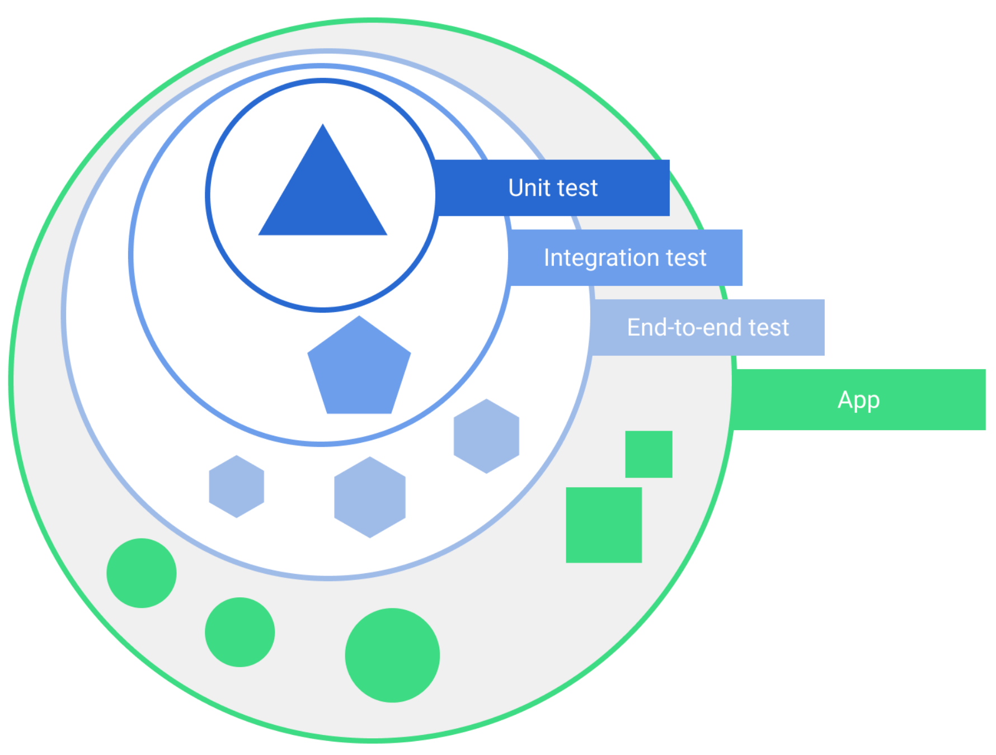
Test Scopes

Slide 5
JUNIT
JUNIT -> Testing framework for java used for unit testing
Some key concepts and features of Junit:
1.Test Methods: Test methods are marked with the @Test annotation.
2.Methods Assertions: It provides a variety of assertion methods,such as assertEquals(),assertTrue(),assertNotNull(),etc,
3.Test Fixtures: Test Fixtures are used to set up the preconditions and define the initial state required for executing a test. Junit offers annotations like @Before.

Slide 6
JUNIT
4.Test Runners: Junit uses test runners to execute tests and provide reporting. Like @RunWith
void assertEquals(boolean expected,boolean actual): checks that two primitives/objects are equal. It is overloaded.
void assertTrue(boolean condition): checks that a condition is true.
void assertFalse(boolean condition): checks that a condition is false.
void assertNull(Object obj): checks that object is null.
void assertNotNull(Object obj): checks that object is not null.

Slide 7
Annotations
@Before
Annotation is used to mark a method that should be executed before each test method in the test class.
It is commonly used to setup the preconditions or initialize the objects and resource required for the tests.
@Test
Annotation is used to mark as a test case.
It indicates that the method should be executed as an individual test.

Slide 8
Annotations
@BeforeClass
To mark methods that should be execute once before all test methods in a test class.
@RunWith
Annotation is used to specify the test runner to be used.
@Ignore -> To skip a test.
@After
To perform clean-up action after each test methods
@AfterClass
To perform clean-up actions after all test methods in a test class.

Slide 9
Nullability
Method arguments and return values are non-null by default
Nullable values will be explicitly annotated with @Nullable
No need to test nulls in most cases.

Slide 10
Test Doubles
Test doubles are objects that is used in place of real dependencies during unit testing.
There are three types of test doubles.
    Fake Objects.
    Stub Objects.
    Mock Objects.

Slide 11
Types of test doubles
Fake Objects :
Fake objects are implementation of dependencies that provide simplified versions of the real objects.
They are typically used when the real objects have external dependencies that are not suitable for testing.
Fakes provide simpler and controlled behavior for testing purposes.

Slide 12
Types of Test double
Stub objects:
Stub objects provide predetermined responses to method calls.
Stubs are used to return fixed values or predefined data that are needed for the test.
Mock Objects:
Mock objects are dynamically created objects that simulate the behaviour of real objects.
They record and verify the interactions with the code under test.
Mocks allow you to set expectations on method calls and verify that they were invoked correctly.

Slide 13
Benefits of Unit testing :
Testability requires good design
Reduces the mental complexity of software development
Prevent bugs
Fast debug
Best documentation

